Slide 1
PROJECT RECYCLE ANALYSIS OF WASTE MANAGEMENT SYSTEM IN THIRUVANANTHAPURAM MUNICIPAL CORPORATION
A Project by
Team BitPlease
Tech Department of Sahridaya

Slide 2
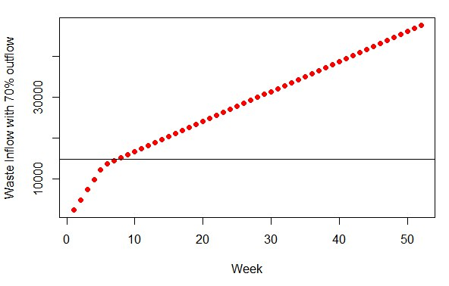
Waste Inflow and Outflow with weeks

Slide 3
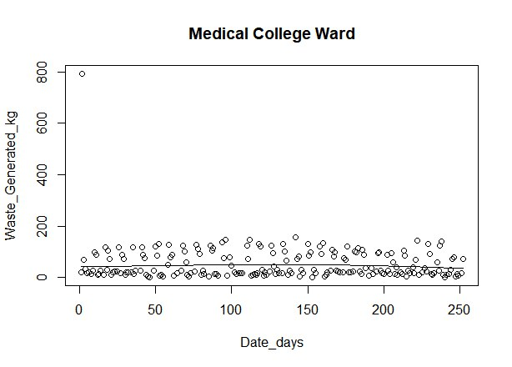

Slide 4
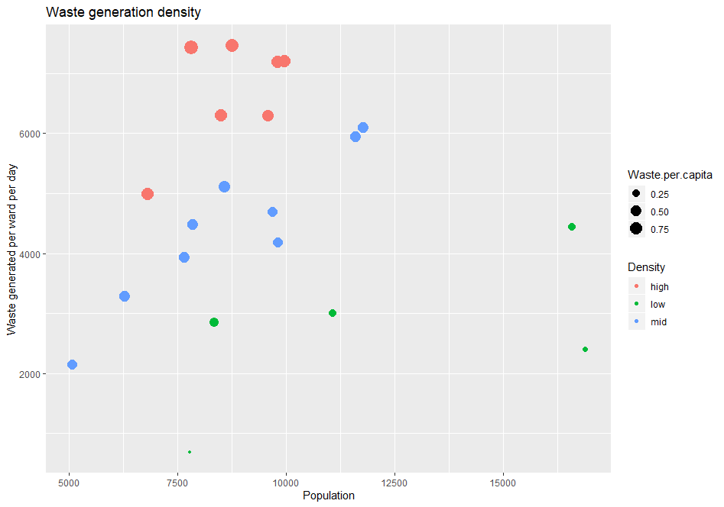

Slide 5
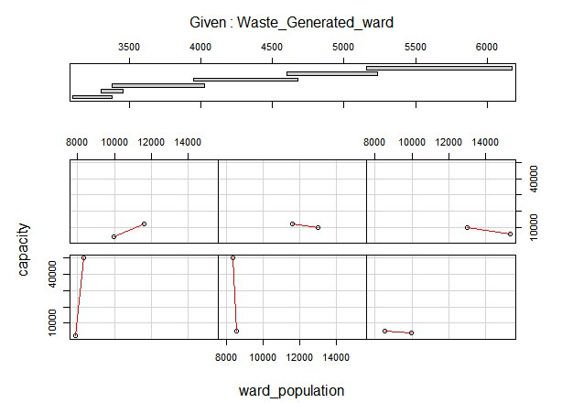

Slide 6
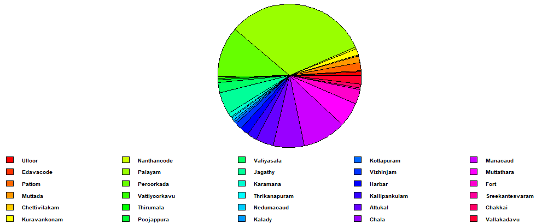
Waste Processing Index

Slide 7
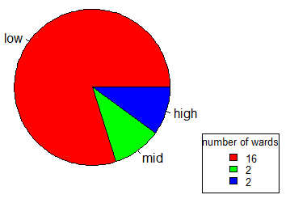
Growth Index

Slide 8
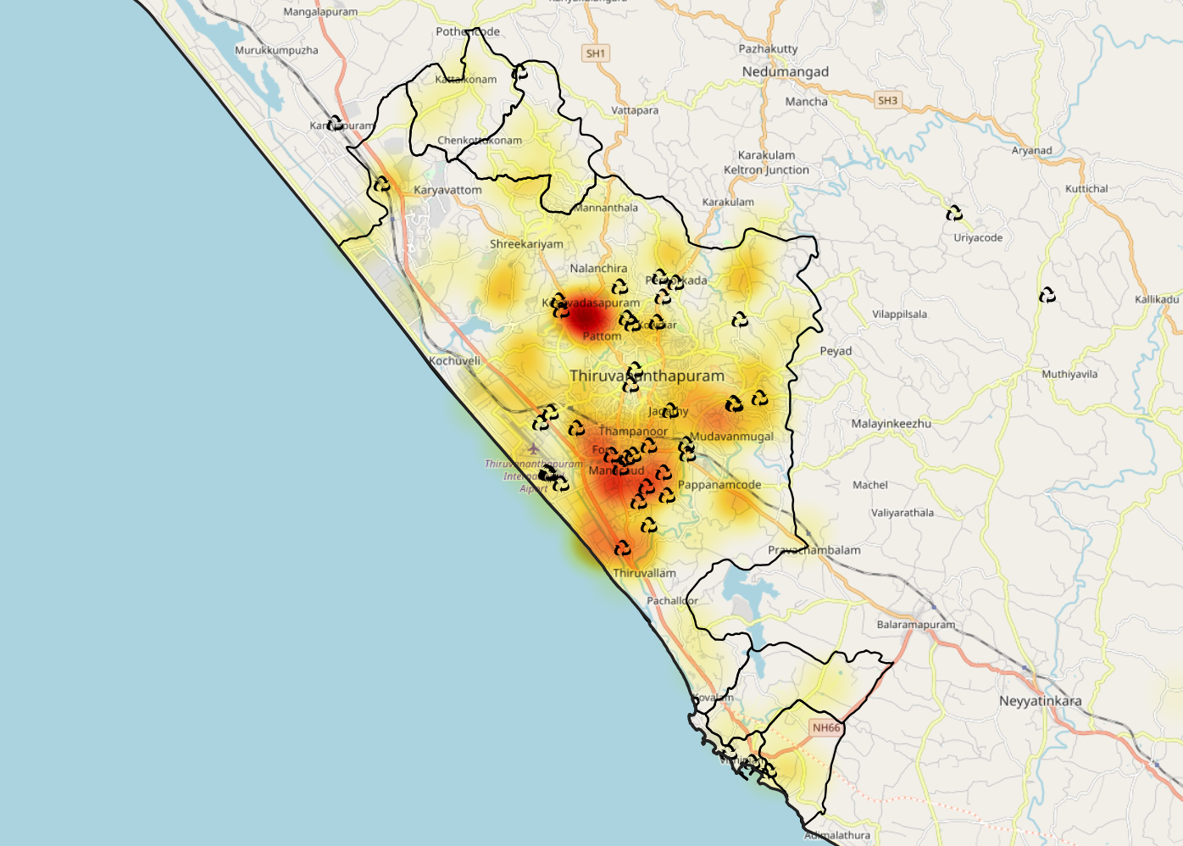
Population density

Slide 9
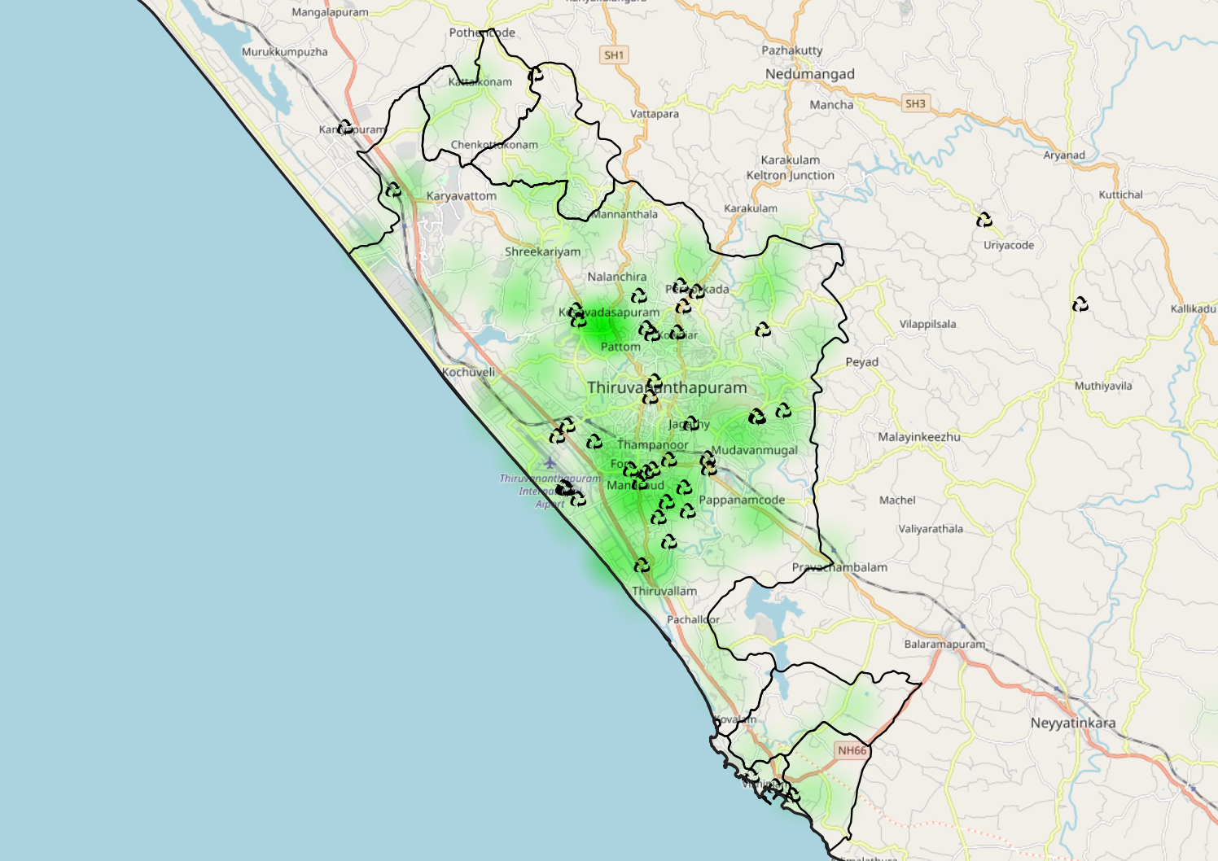
Waste generation density and location of aerobic bins

Slide 10
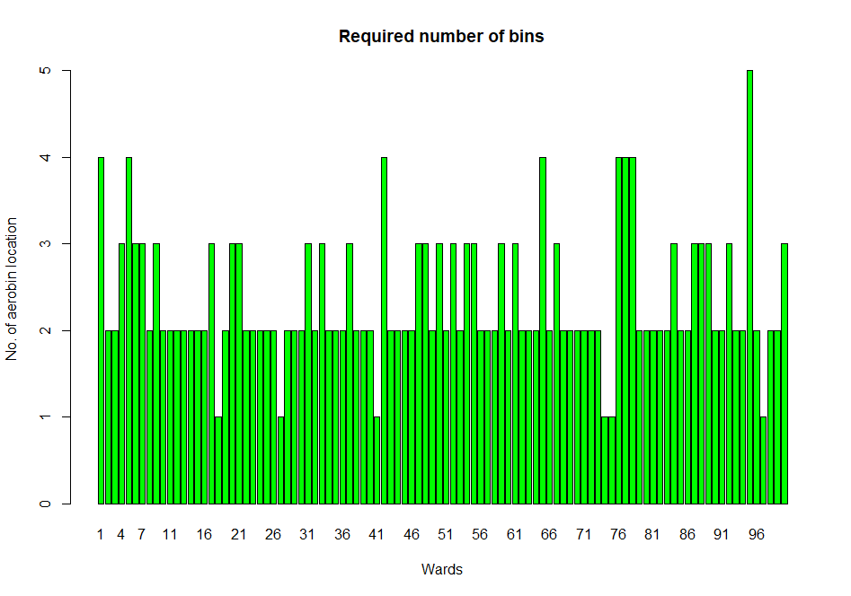

Slide 11
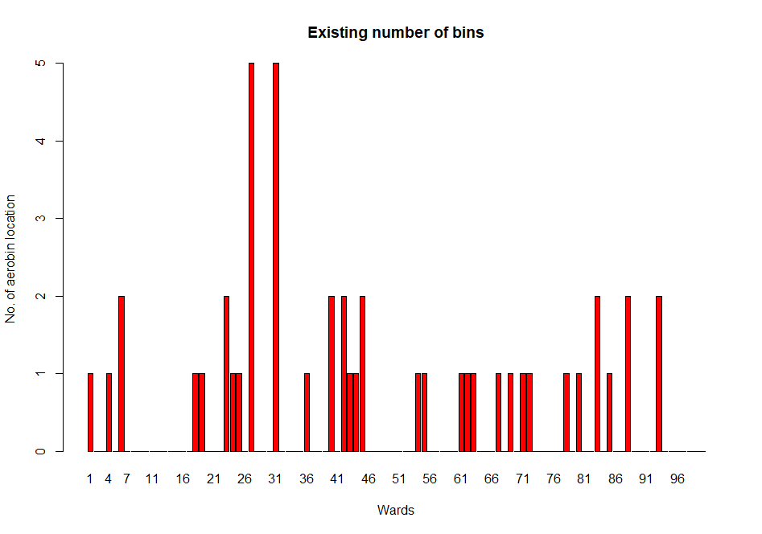

Slide 12
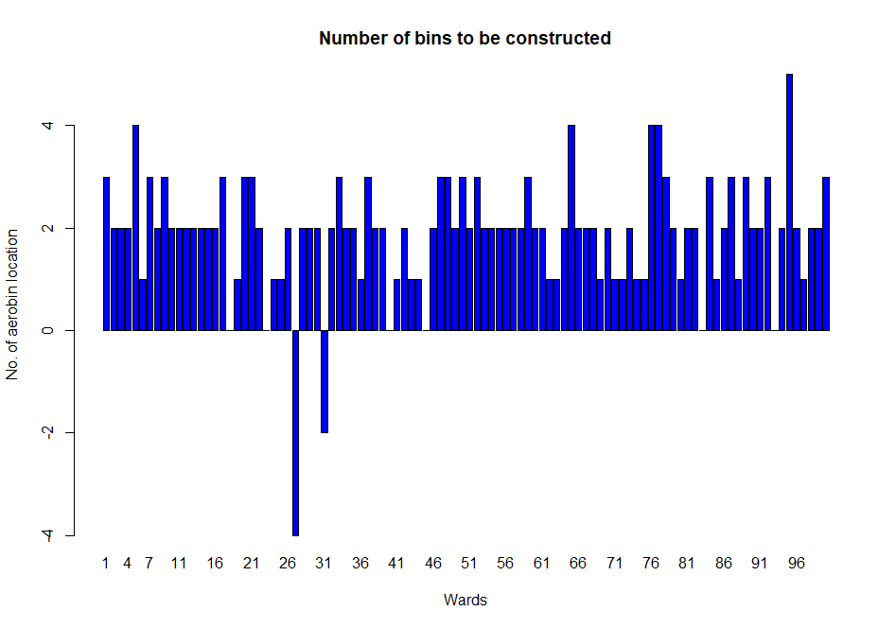

Slide 13
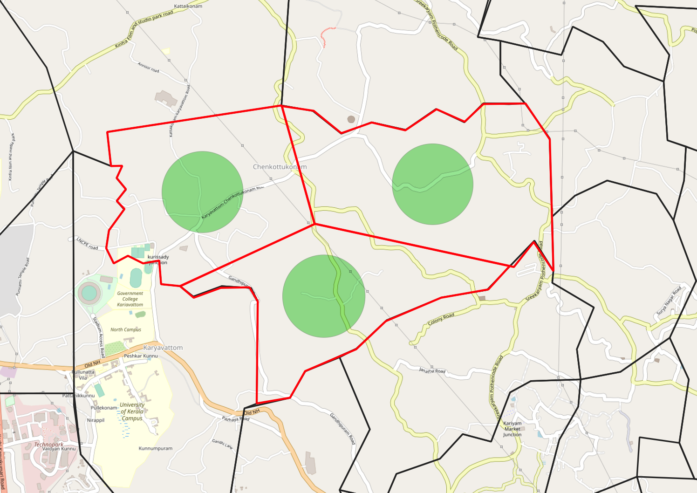
Represents the range within which the aerobin should be placed.
Represents division of ward area.

